Slide 1
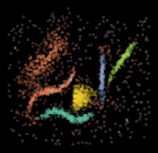
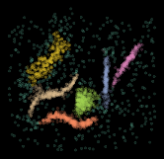
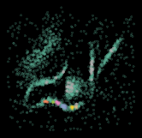
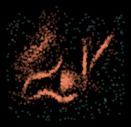


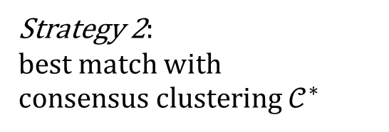

D
$$Λ(S)$$
Strategy 1: ANMI maximization
produce ensemble
data
S
produce consensus clustering
Strategy 2:
best match with
consensus clustering $𝒞^{∗}$
$$𝒞^{∗}$$
hyperparameter
configurations

Slide 2
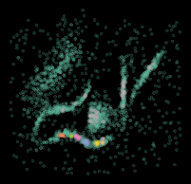




Slide 4
